Slide 1
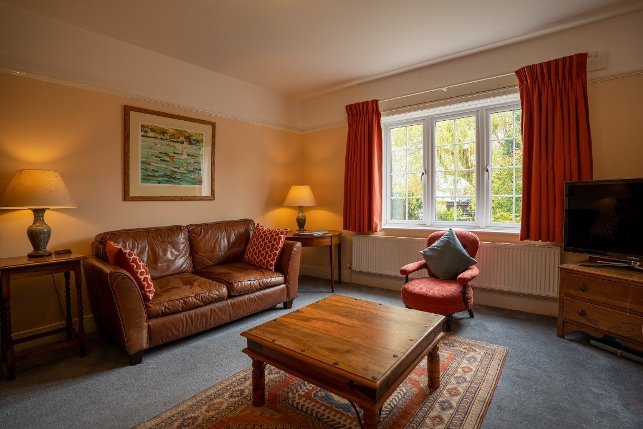
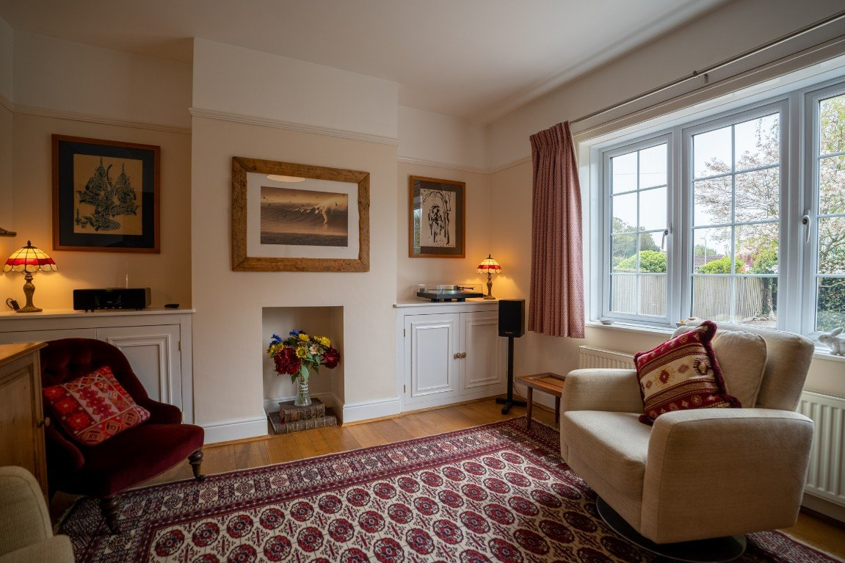
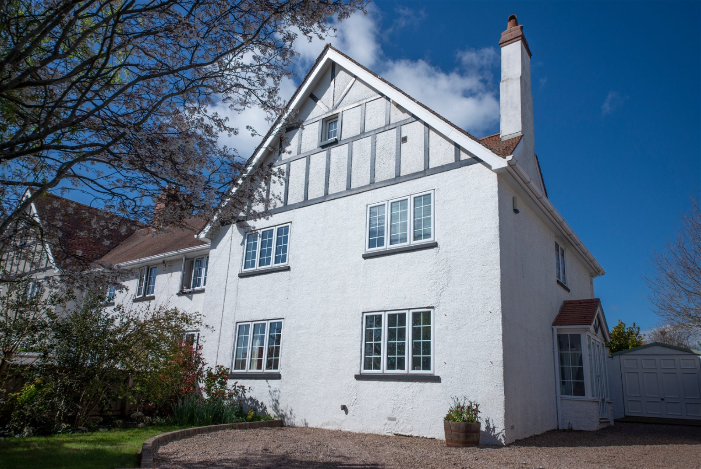
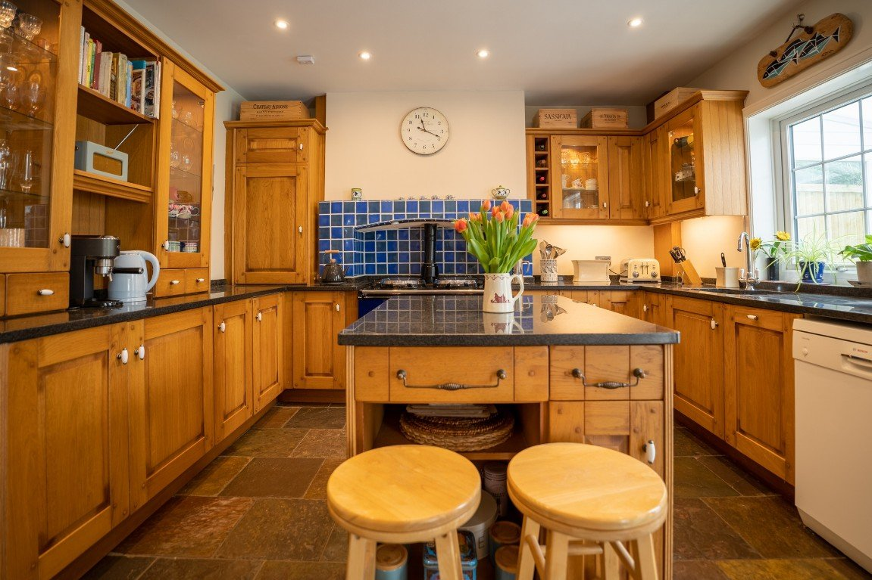
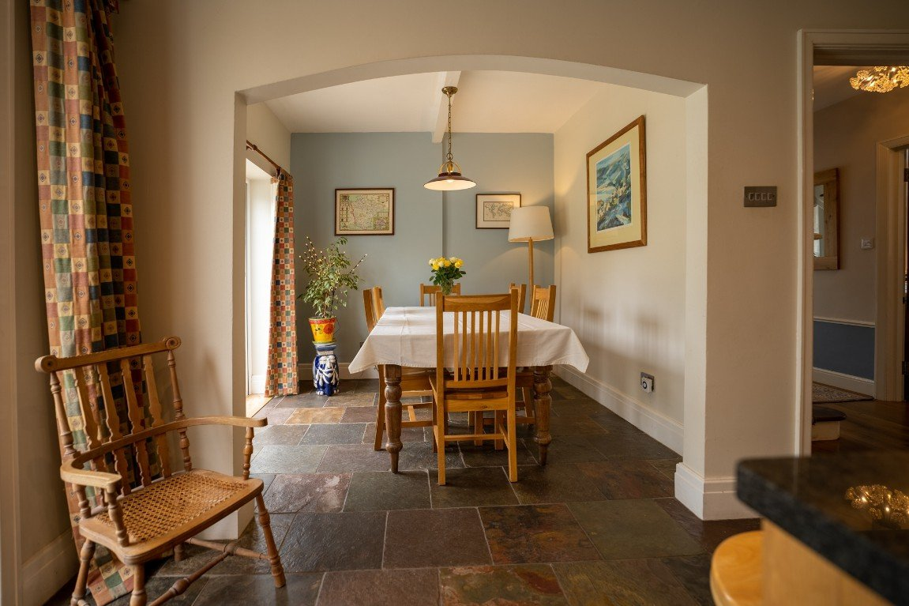
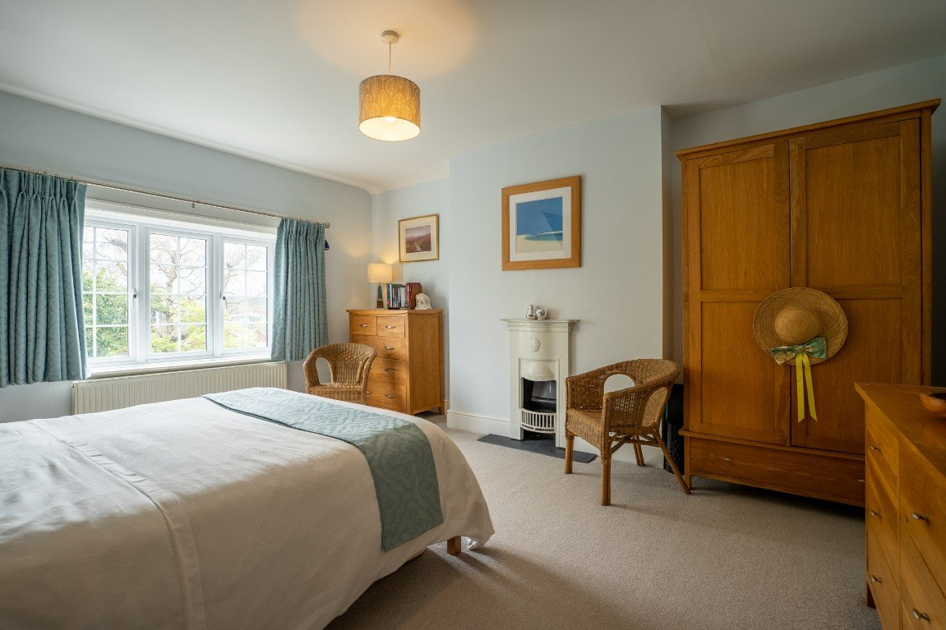
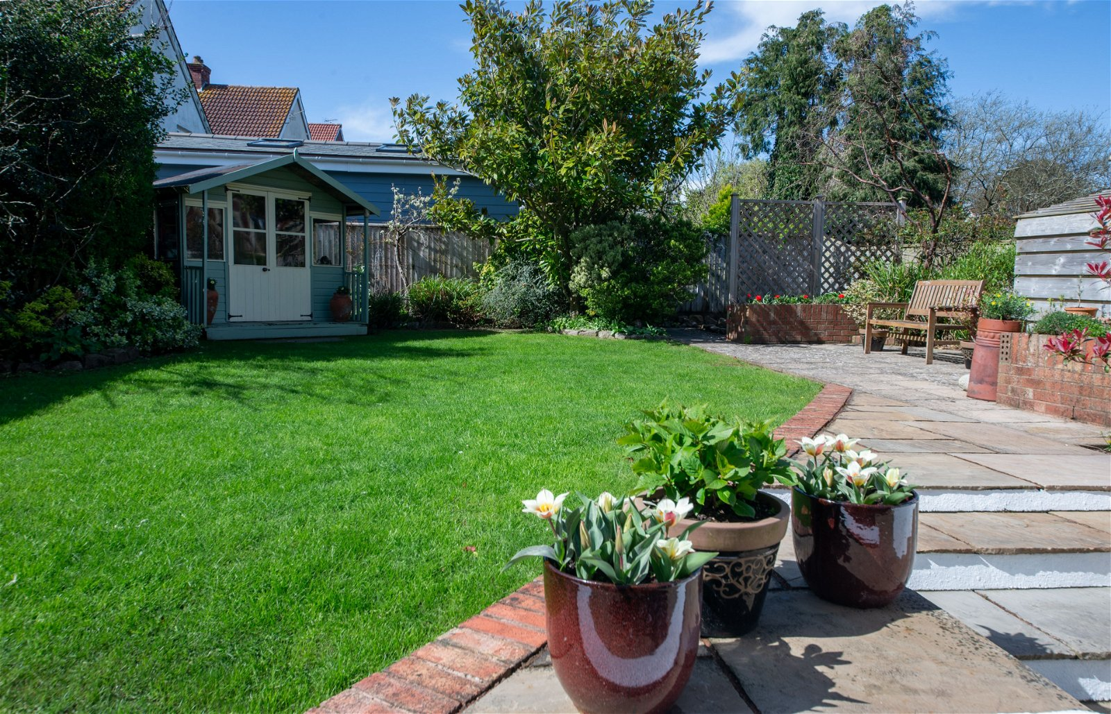
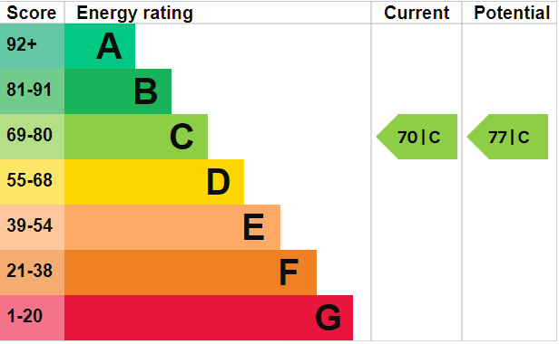
www.pennys.net
49 Cranford Avenue, Exmouth, Devon, EX8 2QF
GUIDE PRICE £640,000
TENURE Freehold
An Exceptional Edwardian Semi-Detached Residence Situated In A Highly Desirable And Convenient Location Offering Spacious High Quality Accommodation With Ample Driveway Parking, Garage And Attractive
Front & Rear Gardens
Entrance Porch & Reception Hall • Lounge & Separate Dining/Sitting Room •
Superb Kitchen/Breakfast Room • Cloaks Area & Ground Floor Cloakroom/WC • Utility Room •
Three Good Size First Floor Bedrooms • First Floor Quality Bathroom Suite &
Separate Cloakroom/WC • Second Floor Bedroom Suite With En-Suite Shower Room/WC •
Gas Central Heating And Double Glazed Windows • Stunning Family Home •
Pennys Estate Agents Limited for themselves and for the vendor of this property whose agents they are give notice that:- (1) These particulars do not constitute any part of an offer or a contract. (2) All statements contained in these particulars are made without responsibility on the part of Pennys Estate Agents Limited. (3) None of the statements contained in these particulars are to be relied upon as a statement or representation of fact. (4) Any intending purchaser must satisfy himself/herself by inspection or otherwise as to the correctness of each of the statements contained in these particulars. (5) The vendor does not make or give and neither do Pennys Estate Agents Limited nor any person in their employment has any authority to make or give any representation or warranty whatever in relation to this property.
PENNYS ESTATE AGENTS
2 Rolle House, Rolle Street, Exmouth, Devon, EX8 2SN
Tel: 01395 264111 EMail: help@pennys.net

Slide 2
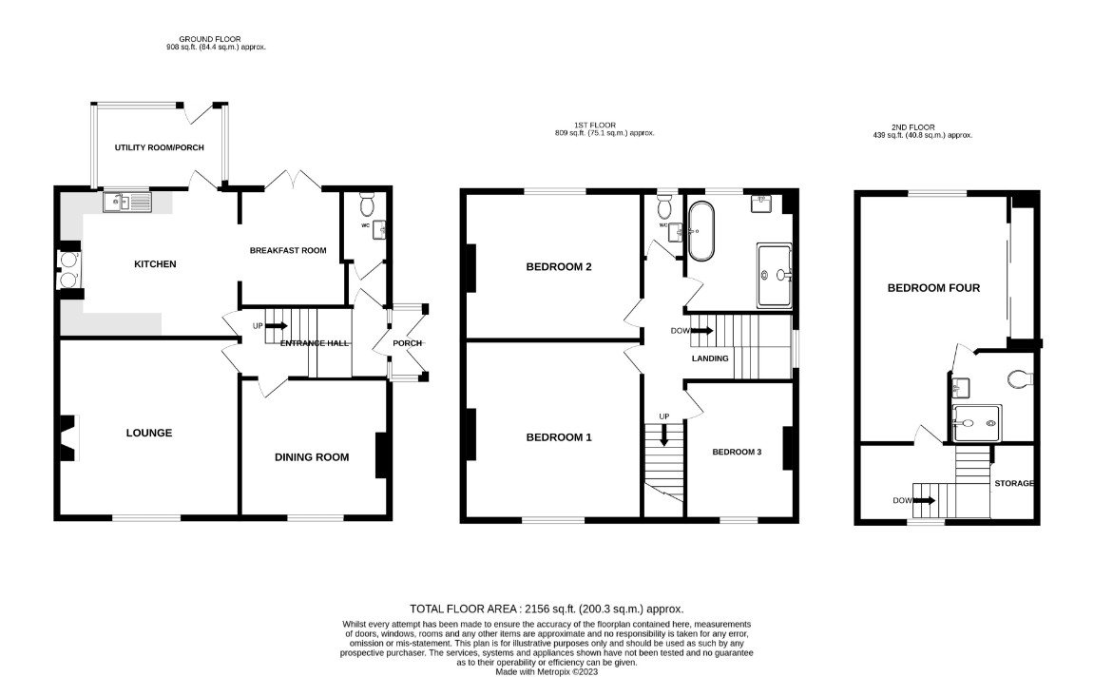
49 Cranford Avenue, Exmouth, Devon, EX8 2QF
THE ACCOMMODATION COMPRISES: uPVC double glazed double doors opening to:
ENTRANCE PORCH:- With courtesy light; wood flooring; uPVC double glazed windows; inner solid wood door with patterned window inset and matching picture window side screens to either side giving access to:
RECEPTION HALL:- A fine entrance to the property with turning staircase rising to the first floor landing; wood flooring; radiator; cupboard housing electric consumer unit and electric meter; dado rail; access to a SIDE CLOAKROOM: Fitted cupboard with display shelf over; coat rack; uPVC double glazed window door to:
GROUND FLOOR WC: -Stylishly fitted with a WC with concealed cistern and push button flush; space saver wash hand basin with chrome mixer tap and cabinet beneath; part tiled walls; chrome heated towel rail; colour coordinated tiled flooring; extractor fan; access to roof space; recess ceiling spotlighting; uPVC double glazed window with patterned glass.
LOUNGE: - 4.7m x 4.06m (15'5" x 13'4") A most attractive room with uPVC double glazed window overlooking the front aspect; feature fire surround with chimney recess housing wood burner standing on a marble-effect hearth; television point; radiator; picture rail.
DINING ROOM: - 3.96m x 3.51m (13'0" x 11'6") A charming room with uPVC double glazed window to front aspect; chimney recess and fitted cabinets in both recesses with display surface over; wood flooring; radiator; picture rail. Used by the current owners as a second sitting room.
KITCHEN: - 4.27m x 3.89m (14'0" x 12'9") A superb room fitted with a range of patterned marble work top surfaces with matching splashbacks; range of cupboards, drawer units and matching wall mounted cupboards incorporating two glass-fronted display units with lighting; integrated wine rack; space for dishwasher; integrated eye-level fridge; inset one and a half bowl sink unit with integrated drainer and antique style chrome mixer tap over; dresser style unit set atop work surface with cupboards beneath; chimney recess housing gas Aga with two warming plates; island unit with marble work top, cupboards, drawer units and shelving; recess ceiling spotlighting; radiator; attractive stone flooring; open archway through to:
BREAKFAST ROOM: - 2.62m x 2.72m (8'7" x 8'11") uPVC double glazed double doors opening onto the rear garden; feature stone flooring.
From the kitchen area a uPVC double glazed door gives access to:
UTILITY ROOM: - 3.18m x 1.8m (10'5" x 5'11") Fitted with a single drainer sink unit set into patterned work top surface with cupboards and plumbing for washing machine beneath; tiled flooring; uPVC double glazed windows overlooking the rear garden; uPVC double glazed door giving access to the rear garden.
FIRST FLOOR LANDING: uPVC double glazed window; radiator; staircase rising to the SECOND FLOOR.
BEDROOM ONE: - 4.7m x 4.11m (15'5" x 13'6") A lovely main bedroom with feature fireplace standing on marble-effect hearth; radiator.
BEDROOM TWO: - 4.27m x 3.89m (14'0" x 12'9") Another good size bedroom with uPVC double glazed window to rear aspect; feature fireplace standing on a marble-effect hearth; radiator.
BEDROOM THREE: - 3.56m x 3.02m (11'8" x 9'11") into wall recess. uPVC double glazed window to front aspect; radiator; understairs storage cupboard. Used by the current owners as an office.
BATH/SHOWER ROOM: - 2.79m x 2.59m (9'2" x 8'6") A spacious room fitted with a high quality suite comprising of a bath; ease of access good size shower cubicle with chrome shower unit with remote start/stop button; wash hand basin with chrome mixer tap and fitted mirror over; extensive attractively tiled walls; chrome heated towel rail; tiled flooring with under-floor heating; shaver socket; recess ceiling spotlighting; uPVC double glazed window partly fitted with patterned glass.
SEPARATE CLOAKROOM/WC: Comprising of a WC with push button flush; space saver wash hand basin with chrome mixer tap, mirror over and cabinet beneath; chrome heated towel rail; attractive extensively tiled walls; tiled flooring; recess ceiling spotlighting; extractor fan; uPVC double glazed window partly fitted with patterned glass.
SECOND FLOOR LANDING AREA: uPVC double glazed window to front aspect; recess ceiling spotlighting; good size fitted storage cupboard on half-landing; door to:
SECOND FLOOR BEDROOM SUITE: - 6.48m x 3.18m (21'3" x 10'5") narrowing to 1.78m (5'10"). A wonderful feature of the property with uPVC double glazed window; range of built-in wardrobes with sliding doors (two mirror-fronted) with clothes rail and shelving; radiator; part sloping ceiling; recess ceiling spotlighting; access to eaves storage space; door to:
EN-SUITE SHOWER ROOM/WC: - 2.34m x 1.93m (7'8" x 6'4") A spacious en-suite shower room comprising of an ease of access good size shower cubicle with shower unit; contemporary style wash hand basin with chrome block mixer tap, mirror with integrated light over and drawer unit beneath; WC with concealed cistern and push button flush; fully attractively tiled walls; colour coordinated tiled flooring with under-floor heating; recess ceiling spotlighting; extractor fan; chrome heated towel rail.
OUTSIDE: Set back from Cranford Avenue enjoying privacy accessed by a wooden gate, the property is approached via a sweeping gravelled driveway and turning area with lawned area of garden edged with mature trees and shrubs and leading to the GARAGE. The REAR GARDEN is worthy of special note being attractively landscaped and planned comprising of an attractive patio area adjoining the rear of the property with outside lighting and cold water tap, a few steps rise to a level lawned area of garden edged with flower and shrub beds. Summer house. Further patio area offering an ideal space for al-fresco entertaining with access to log store and vegetable plot. The garden is west facing, fully enclosed and offers a high degree of privacy and seclusion.
GARAGE: - 4.98m x 2.51m (16'4" x 8'3") With up and over door; power and light connected; window; door giving access to the rear garden.

